Slide 1


Wrestling student-Athlete
Seniors
2020-21

Slide 2
Augustana men’s
wrestling

Slide 3
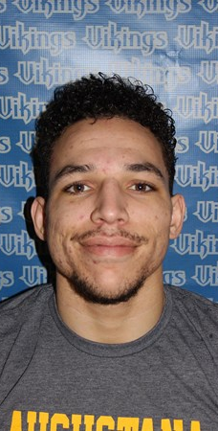
Josh bush
Hometown: Moline, Il
Academic Major(s): Communication studies/Mass Communication, Multimedia Journalism
Post-Collegiate Plans: Hope to land a career in the Multimedia journalism industry working for a reputable News Corporation.

Slide 4
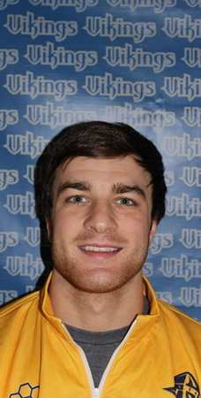
Frankis faasen
Hometown: Lake Como, NJ
Academic Major: Accounting
Post-Collegiate Plans: After college will be going back to New Jersey to start working in the Accounting field. While also pursuing my CPA in accounting.

Slide 5
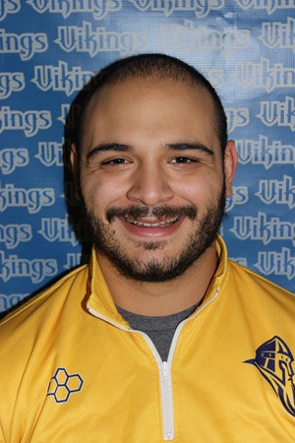
Andrew Gonzalez
Hometown: Skokie, IL
Academic Major: International Business
Post-Collegiate Plans: I intend on attending law school hopefully at Stetson University in Tampa, Florida where I plan on getting my international law degree.

Slide 6
Dan terronez
Hometown: Moline, IL
Academic Major: Economics
Post-Collegiate Plans: I will be working in the Dental IT field for the next year, while staying involved in the sport through coaching. The following year, I plan on pursuing an MBA and exploring other opportunities.

Slide 7
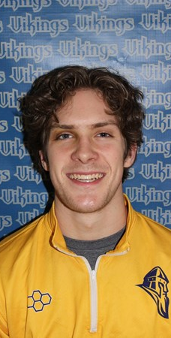
Neil o’shaughnessy
Hometown: Niles, Illinois
Academic Major: Psychology and Pre-Medicine
Post-Collegiate Plans: I plan to pursue a career in clinical psychology, and to eventually go into psychotherapy. Currently, I am waiting to hear back from several PhD programs in regards to their decision.

Slide 8

Concordia-wisconsin men’s
wrestling

Slide 9
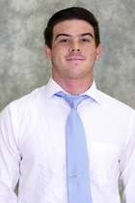
MERRICK O’DONNELL
Hometown: Huntington Beach, CA
Academic Major: Justice and Public Policy
Post-Collegiate Plans: After college I plan on going into the military or local law enforcement. I wish to be the change in this world and make the world a better place one day at a time.

Slide 10

Elmhurst men’s
wrestling

Slide 11
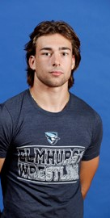
SCOTT ANDERSON
Hometown: Wheeling, IL

Slide 12
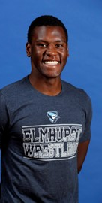
NEVIN BRITTAIN
Hometown: Haslett, MI

Slide 13
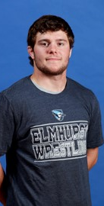
JIMMY MCAULIFFE
Hometown: Burbank, IL

Slide 14
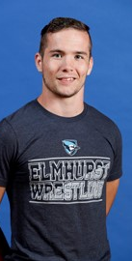
JOE RONGAUS
Hometown: Woodridge, IL

Slide 15

Lakeland men’s
wrestling

Slide 16
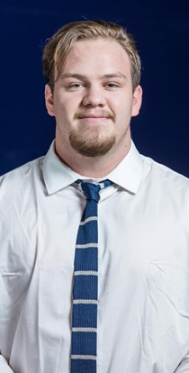
GARRET HUNT
Hometown: Corvallis, Montana
Academic Major: Business Administrations
Post-Collegiate Plans: My plan is to go home to MT for a few months to be with family and friends, then move to Wisconsin to begin my career in social media/real estate marketing.

Slide 17
Millikin men’s
wrestling

Slide 18
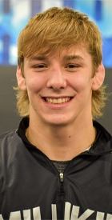
BRADON BIRT
Hometown: Decatur, Illinois
Academic Major: Sports Management
Post-Collegiate Plans: The plan is to either continue in the wrestling world with competing or coaching, or to get into real estate and house renovating. Whatever happens, happens.

Slide 19
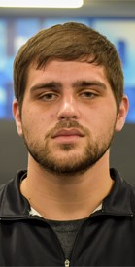
HUNTER CROWLEY
Hometown: Mahomet, IL
Academic Major: Bachelor of Science in nursing
Post-Collegiate Plans: After I graduate, I plan on taking and passing my NCLEX to become a Registered Nurse. Following this I want to work in an emergency room or ICU setting.

Slide 20
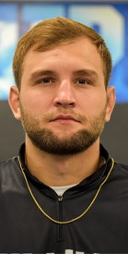
LOGAN HAGERBAUMER
Hometown: Quincy, Illinois
Academic Major: Sport Management
Post-Collegiate Plans: I plan to start the process of becoming a UPS driver. I will also be looking for a wrestling program to give back to in the city that I am living in after I graduate.

Slide 21
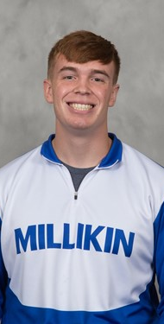
DANIEL MCNALLY
Hometown: Grant Park, IL
Academic Major: Nursing
Post-Collegiate Plans: I will work as a Registered Nurse in the Decatur Memorial Hospital Intensive Care Unit. Afterwards, I would like to transition into travel nursing to work all around the country.

Slide 22

Milwaukee school of engineering men’s
wrestling

Slide 23
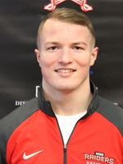
DREW MATTICKS
Hometown: Oak Park, IL
Academic Major: Mechanical Engineering

Slide 24
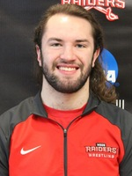
GARRETT MULKERIN
Hometown: Chicago, IL
Academic Major: Mechanical Engineering

Slide 25
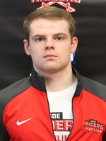
HELTON VANDENBUSH
Hometown: Belgium, WI
Academic Major: Mechanical Engineering

Slide 26

North central Wrestling

Slide 27
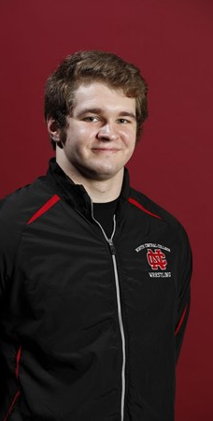
BEN BERGEN
Hometown: Oak Park, IL
Academic Major: Exercise Science
Post-Collegiate Plans: I am looking to get into paramedic school, then work on becoming a firefighter. I also plan to continue wrestling and begin coaching after graduation.

Slide 28
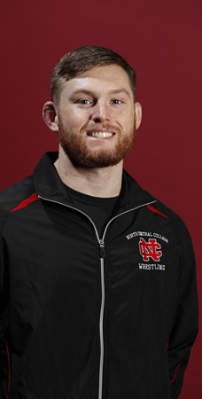
ERIC HOMINAC
Hometown: Schaumburg, IL.
Academic Major: Exercise Science, B.S.
Post-Collegiate Plans: After graduating from North Central College, I will be attending Rosalind Franklin University where I will be joining their Doctor of Physical Therapy program.

Slide 29
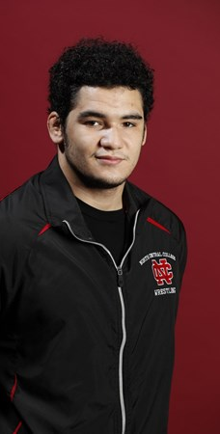
RAFAEL ROMAN
Hometown: Edwardsville, IL
Academic Major: Marketing
Post-Collegiate Plans: Working as an Account Manager for Impact Networking.

Slide 30
wheaton men’s
wrestling

Slide 31
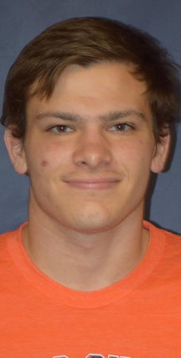
SEAN FERGUSON
Hometown: Boise, ID
Academic Major: Business/Economics and Applied Mathematics

Slide 32
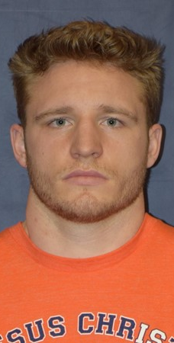
HUNTER HARRISON
Hometown: Castle Rock, CO
Academic Major: Business/Economics

